Slide 1
SNHU Travel Scrum-Agile Project
David France
CS-250
6/15/23

Slide 2
Roles of a Scrum Team
Product Owner
Scrum Master
Developers
Testers
Oversees project
Communicates with client and upper levels of organization
Sets User Stories for team
Creating a clear and transparent Product Backlog
Acts as intermediary between Scrum Team and client throughout development
Oversees Daily Scrums
Same organizational level as rest of team
Acts as both guide and source of knowledge
Removes obstacles for rest of the team
Keeps Daily Scrums on track
Produces high-quality code to turn User Stories into completed work
Communicates with rest of Scrum Team on what has been done, what they’re working on next, and any challenges
Adapts to daily changes
Communicates questions effectively
Develops tests to ensure Developer output meats User Story criteria
Communicates with rest of Scrum Team on what has been done, what they’re working on next, and any challenges
Works with developers on test-driven development
Adapts to daily changes
(Schwarber & Sutherland, 2020)

Slide 3


Phases of Software Development Lifecyle using Agile
Daily Scrum
Completed user story
Sprint Review
2-4 week sprints
Develop and Test
*Sprints iterated until product is completed
Plan
Design – create user stories and backlog
Completed product
Launch
(Nehra, 2023)

Slide 4
Phases of Software Development Lifecyle using Agile - Details
Plan
Product Owner gets requirements from client
Scrum Team Charter is created
Initial User Stories and Product Backlog created
Team estimates time needed for initial stories
Each sprint starts with User Stories and Product Backlog that will be completed
Test-driven development used to turn User Stories into completed code
Daily Scrums are a key part of each sprint, keeping the team on track
Sprint review at the end of each sprint to address successes and failures
Iterate through sprint cycles until project is complete
2-4 week sprints
Daily Scrum
Completed product
Launch
When all User Stories are completed, project should be ready to launch
This is not the end of the development lifecycle
Provide continued support to client for launched product
Begin work on updated version

Slide 5
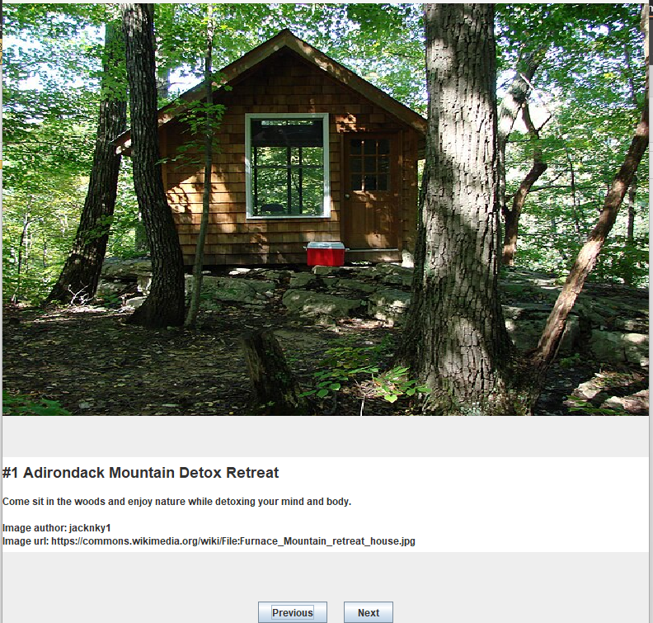

How SNHU Travel project would have been different with waterfall
Some User Stories were changed mid-sprint, notably the Top Five Destinations story
The client decided they wanted a slideshow of Top Five detox/wellness vacations
This would not have been addressed until after we delivered a bad product, putting the client behind schedule
Under Agile we delivered
Waterfall would have delivered
Completed project the client wanted
Completed project the client thought they wanted, but didn’t
Extra time to deliver what the client ended up wanting:
Extra time to deliver what the client ended up wanting:
0 Days
??? Days/Weeks
*We would have had to design, develop, then test the new product, step-by-step again

Slide 6


Factors for choosing Waterfall or Agile
What type of project?
Does the project have clear goals that are unlikely to change?
Microsoft PowerPoint stock images
Microsoft PowerPoint stock images
When to use Agile:
Different phases, such as development and testing, can be done concurrently
The client provides feedback during each iteration
When requirements may change during development to adapt to changing business needs
Often applicable in software development where technological advancement is fast
When to use Waterfall
If the requirements for completion can be defined prior to starting and are unlikely to change
Projects where it is important to follow a plan-driven approach
Classic examples would be building or structural engineering, such as installing an electrical circuit or building a bridge. Many projects that must meet pre-defined specifications or standards
(Cobb, 2015)

Slide 7
References
Cobb, C. (2015). The Project Manager's Guide to Mastering Agile: Principles and Practices for an Adaptive Approach. Hoboken: John Wiley & Sons.
Nehra, M. (2023, May 11). 6 Stages of the Agile Development Lifecycle. From Decipher Zone: https://www.decipherzone.com/blog-detail/agile-development-lifecycle
Schwarber, K., & Sutherland, J. (2020, November). The 2020 Scrum Guide. From Scrum Guides: https://scrumguides.org/scrum-guide.html

